Slide 1
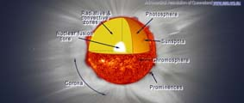
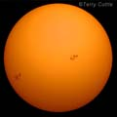
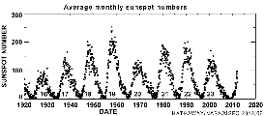
Total Solar Eclipse 14 November 2012
Astronomical Association of Queensland www.aaq.org.au Science Teachers Association of Queensland www.staq.qld.edu.au
The Sun

Slide 2
WARNING:
Never look directly at the bright surface of the Sun without proper eye protection as permanent eye damage may result.
This applies at any time and especially during the partial phases of a solar eclipse.
Refer to the advice issued by the Queensland Government about how to view the eclipse safely.
http://www.fairtrading.qld.gov.au/safe-viewing-of-astronomical-events.htm

Slide 3
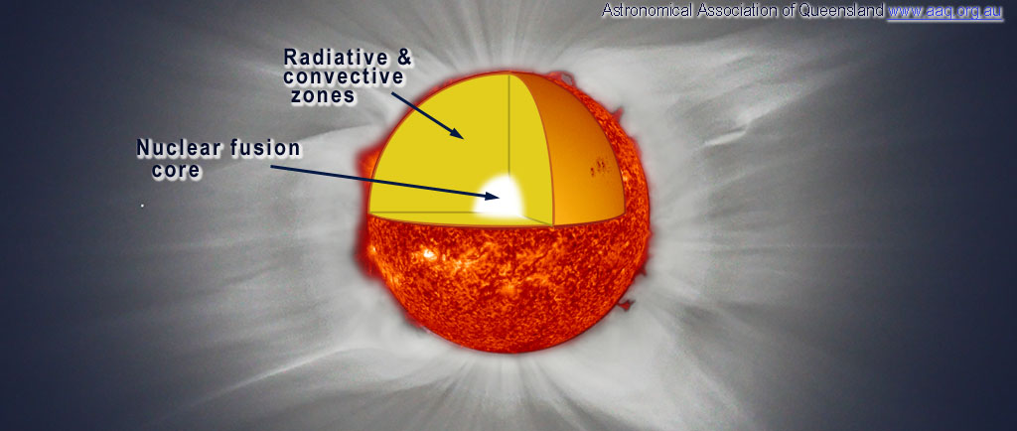
Structure of the Sun
The Sun is a ball of very hot gas.
The Sun’s energy is generated in its Nuclear Fusion Core.
The energy slowly makes its way to the surface through the Radiative and Convective Zones.

Slide 4
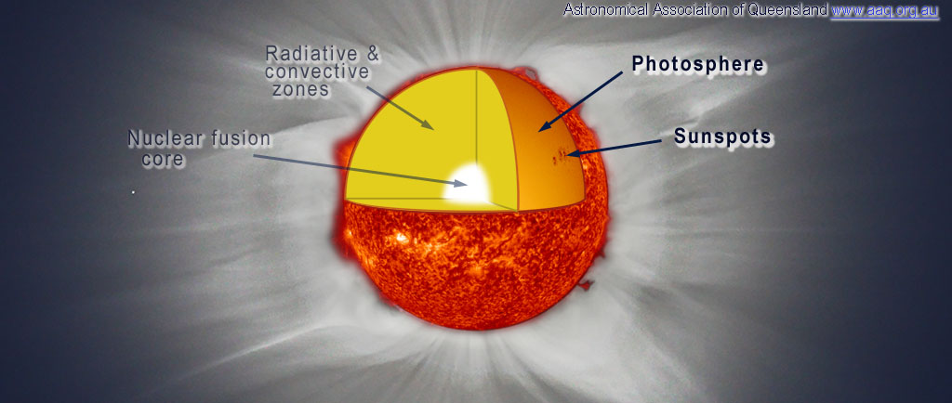
Structure of the Sun
The extremely bright surface of the Sun is called the Photosphere.
There are often Sunspots on the photosphere.

Slide 5
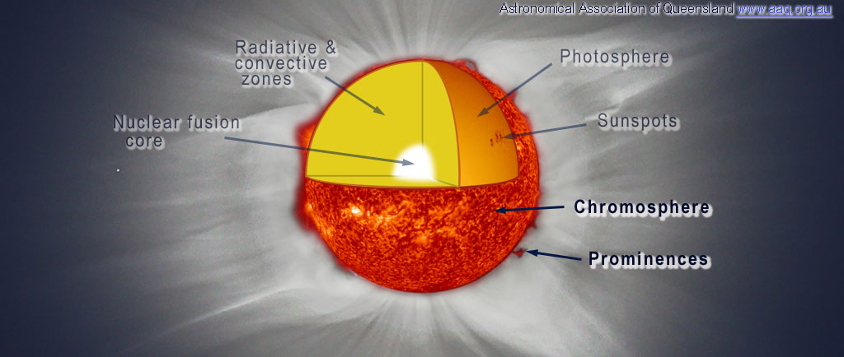
Structure of the Sun
The Chromosphere is a crimson red thin layer of very hot gas just above the photosphere made of glowing hydrogen.
Prominences are glowing loops of hydrogen which are often suspended in the Sun’s magnetic field above the chromosphere.

Slide 6
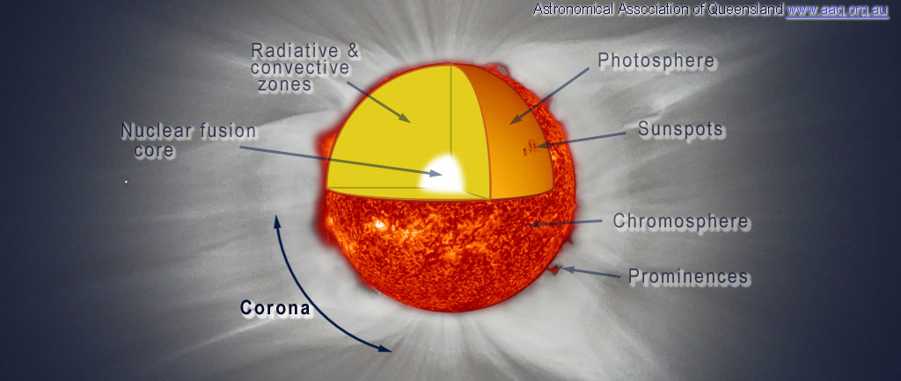
Structure of the Sun
The Sun is surrounded by a tenuous layer of extremely hot gas called the Corona that streams out from the Sun in a pattern formed by the Sun’s magnetic field.
The corona is one of the amazing sights of a total solar eclipse.

Slide 7
Sunspots
Sunspots are relatively cool regions of the Sun’s surface where the Sun’s magnetic field is especially strong.
Sunspots tend to occur in groups and each spot can last for weeks.
By using special safe viewing methods, it is possible to observe sunspots as they form and move (due to the Sun’s rotation) across the surface.

Slide 8
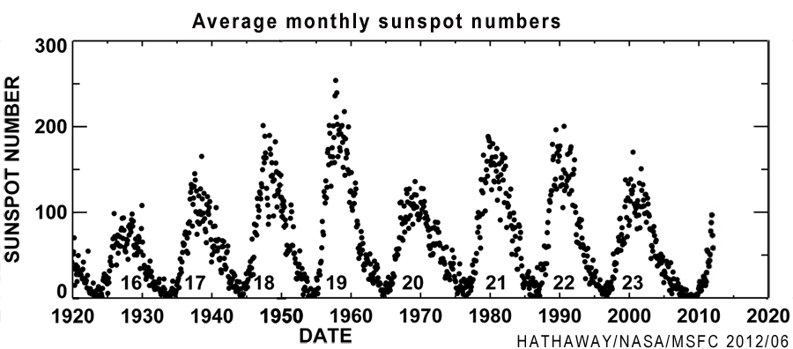
Sunspot Numbers
The number of sunspots on the Sun increases and decreases over an 11 year period.
Sunspot numbers are expected to approach a maximum in 2013.
Increasing sunspot numbers are a good indication of the Sun’s activity. During sunspot maximum, the view of the corona and prominences during a total solar eclipse is generally more dramatic.

Slide 9
Sun Facts and Statistics
Diameter 1 392 000 km:
= 109 times the diameter of the Earth.
Distance from Earth:
Perihelion (minimum distance) 147 098 000 km;
Aphelion (maximum distance) 152 098 000 km;
Average distance 149 597 870 km. This is known as the Astronomical Unit.
Mass is 1.99 x 10³⁰ kg:
= 333 000 Earths and about 99.8% of the mass of the solar system.
Rotation period at the equator is 25.05 days.
Composition by mass approximately 75% hydrogen, 24% Helium, 1% other.
The time taken for light to travel from the Sun to the Earth is about 8.3 minutes:
so we see the Sun as it was about 8.3 minutes ago.

Slide 10
Total Solar Eclipse 14 November 2012
Astronomical Association of Queensland www.aaq.org.au Science Teachers Association of Queensland www.staq.qld.edu.au
The Sun
This presentation is copyright by the Astronomical Association of Queensland and the Science Teachers Association of Queensland. It may be freely reproduced and/or modified provided that it is for non-commercial purposes and the source is acknowledged.
Address any request for use of the material for commercial purposes to eclipse@aaq.org.au

