Slide 1
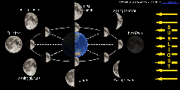
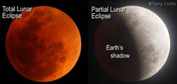
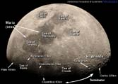
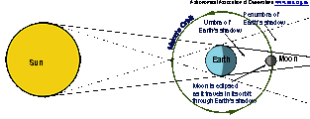
Total Solar Eclipse 14 November 2012
Astronomical Association of Queensland www.aaq.org.au Science Teachers Association of Queensland www.staq.qld.edu.au
The Moon and Lunar Eclipses

Slide 2
WARNING:
Never look directly at the bright surface of the Sun without proper eye protection as permanent eye damage may result.
This applies at any time and especially during the partial phases of a solar eclipse.
Refer to the advice issued by the Queensland Government about how to view the solar eclipse safely.
http://www.fairtrading.qld.gov.au/safe-viewing-of-astronomical-events.htm

Slide 3
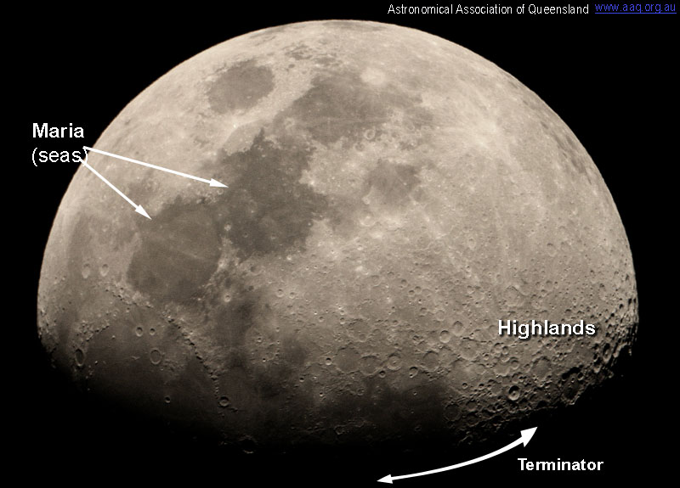
Features on the Moon
Key Features
The Moon has large dark flat areas called Maria (or seas); and bright rugged areas covered in craters called Highlands.
It is easiest to see features near the Terminator, the line separating light from dark (or day from night) on the Moon.

Slide 4
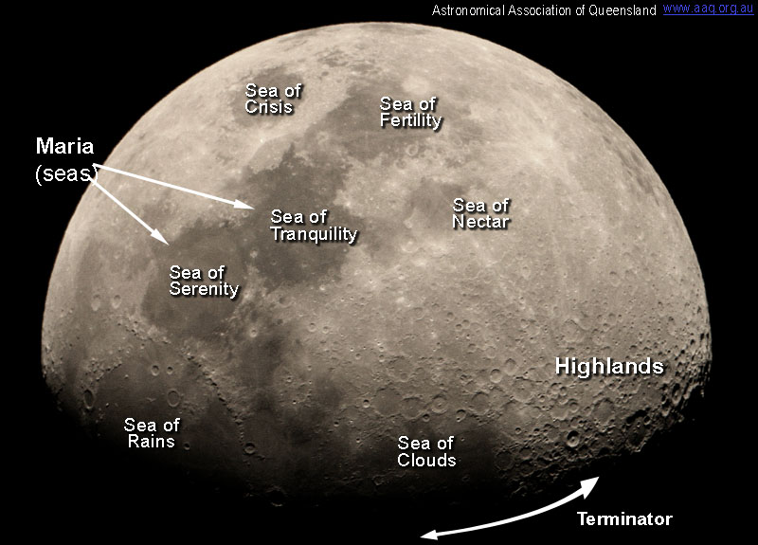
Features on the Moon
Maria (seas)
The dark flat areas called maria are not water but have been made by lava flowing up from below the Moon’s surface.
The lava covered the craters that were there previously.
Craters in the maria have been formed by meteorites hitting the Moon since the maria were formed.

Slide 5
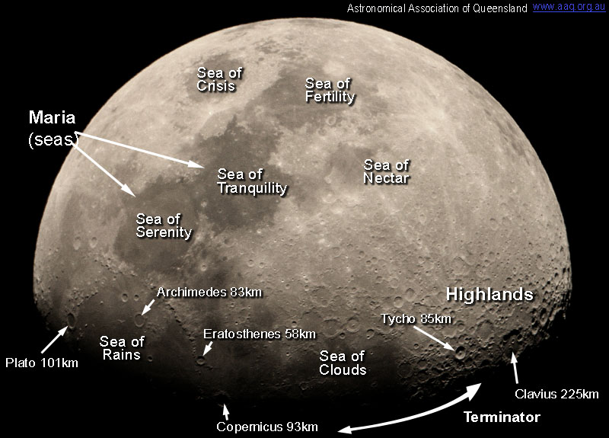
Features on the Moon
Craters on the Moon
Craters on the Moon have mostly been formed by impacts by meteors.
Most craters are circular and some are over 100 km in diameter.
Large craters are several kilometres deep and some have a central peak (e.g., Tycho has a central peak and is 4.8 km deep).

Slide 6
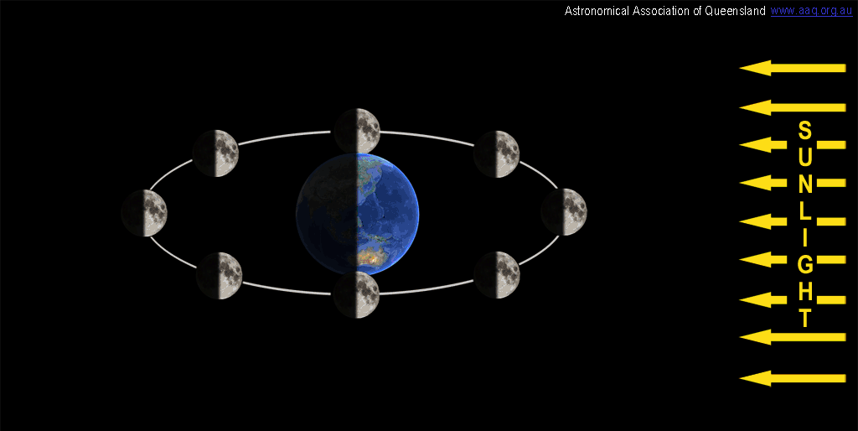
Moon Phases - 1
One half of the Earth and the Moon are always lit by sunlight.

Slide 7
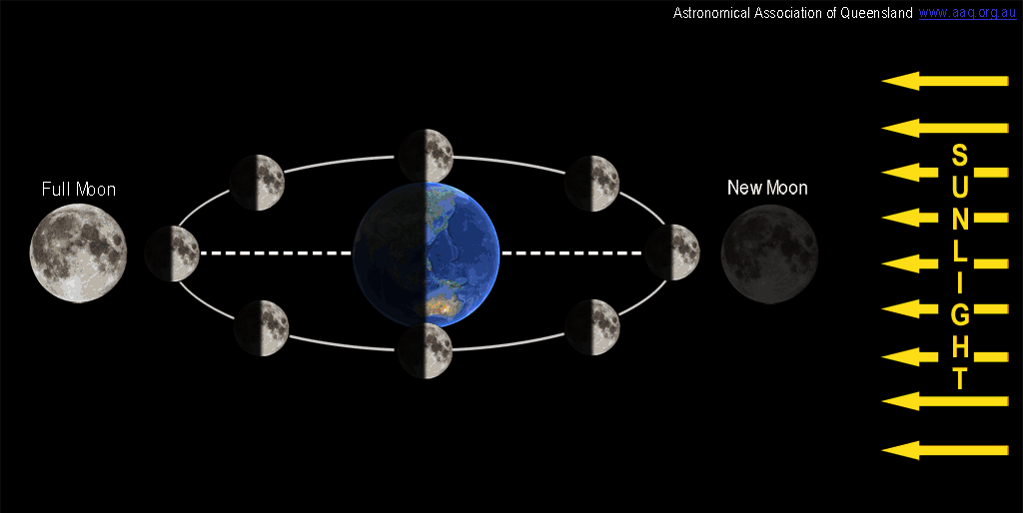
Moon Phases - 2
When the Moon is opposite the Sun we see a Full Moon.
When the Moon is towards the Sun we see a New Moon.

Slide 8
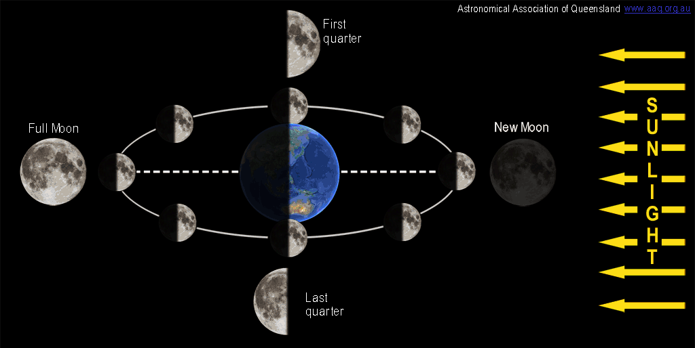
Moon Phases - 3
When the Moon is at right angles to the Sun, from Earth we see the Moon as First Quarter and Last Quarter.

Slide 9
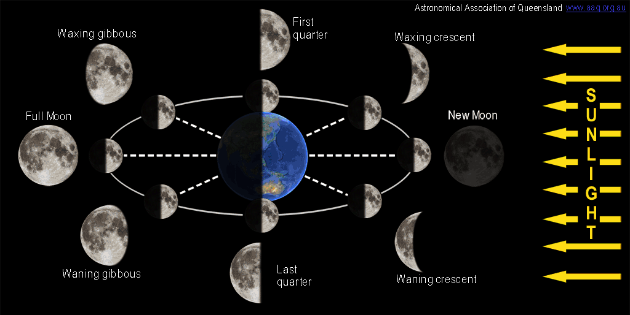
Moon Phases - 4
Between the quarters the Moon will be Gibbous (hump like) or Crescent; and Waxing (increasing) or Waning (decreasing).

Slide 10
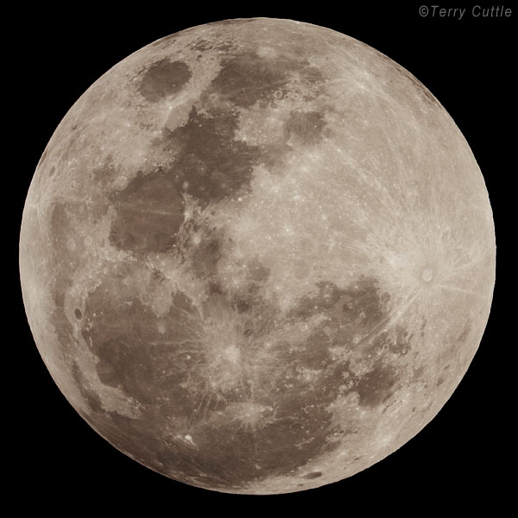
Moon Facts and Statistics
Diameter 3 476 km:
about ¹/₄ diameter of Earth).
Distance from Earth: Perigee (min) 356 400 km; Apogee (max) 406 700 km; Average 384 400 km.
Mass 7.348 x 10²² kg:
about ¹/₈₀th of Earth).
Inclination of the Moon’s orbit to the ecliptic (plane of the Earth’s orbit) is 5.145º.

Slide 11
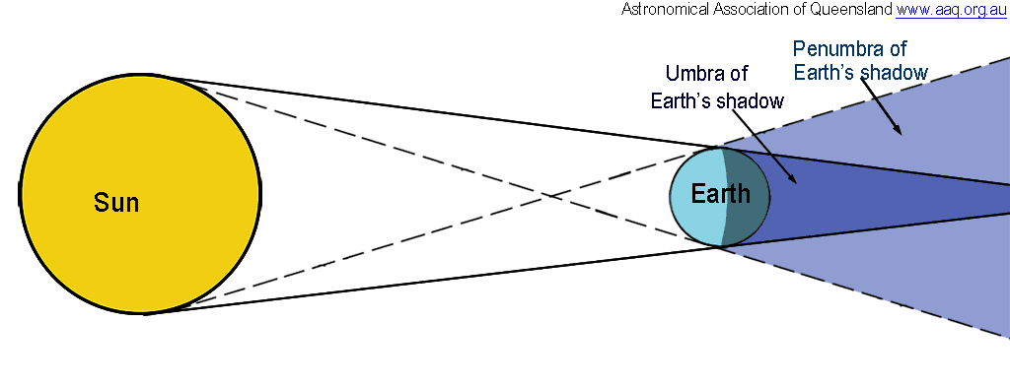
Eclipse of the Moon
The Earth casts a shadow in space on the opposite side to the Sun.
The Umbra is the dark inner part of the shadow.
The Penumbra is the the lighter outer part of the shadow.

Slide 12
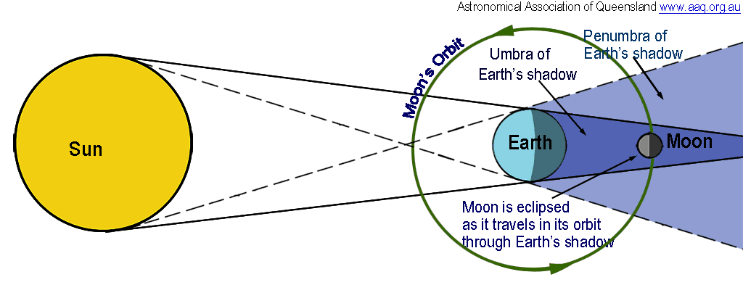
Eclipse of the Moon
An Eclipse of the Moon occurs when the Moon moves into the Earth’s shadow.
A lunar eclipse can only occur at full moon.

Slide 13
Types of Lunar Eclipses - 1
The Moon’s orbit is inclined to the ecliptic (Earth’s orbit around the Sun).
At each full moon, the Moon usually passes above or below the Earth’s shadow in space.
There will be no lunar eclipse.

Slide 14
Types of Lunar Eclipses - 2
Sometimes the Moon in its orbit, is in line with the ecliptic.
The moon passes through the umbra of the Earth’s shadow.
There will be a Total Lunar Eclipse.

Slide 15
Types of Lunar Eclipses - 3
Sometimes the Moon in its orbit, is a little off line with the ecliptic.
The moon passes through the edge of the umbra of the Earth’s shadow.
There will be a Partial Lunar Eclipse.
The Moon is only partially immersed in the Earth’s shadow.

Slide 16
Types of Lunar Eclipses - 4
Sometimes the Moon in its orbit, is more off line with the ecliptic.
The moon passes through the penumbra of the Earth’s shadow.
There will be a Penumbral Lunar Eclipse.
The only effect is a slight darkening in the appearance of the Moon.

Slide 17
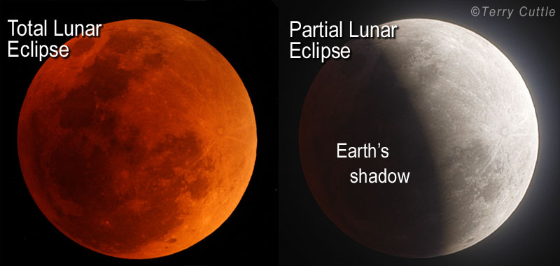
Appearance of a Lunar Eclipse
With a Total Lunar Eclipse no sunlight shines directly on the Moon. The Moon is illuminated by light which is refracted around through the Earth’s atmosphere causing it to be red.
With a Partial Lunar Eclipse only part of the Moon enters the Earth’s shadow.

Slide 18
Total Solar Eclipse 14 November 2012
Astronomical Association of Queensland www.aaq.org.au Science Teachers Association of Queensland www.staq.qld.edu.au
The Moon and Lunar Eclipses
This presentation is copyright by the Astronomical Association of Queensland and the Science Teachers Association of Queensland. It may be freely reproduced and/or modified provided that it is for non-commercial purposes and the source is acknowledged.
Address any request for use of the material for commercial purposes to eclipse@aaq.org.au

